Slide 1
PROJECT TITLE/PROBLEM STATEMENT
Employee burnout is a state of physical, emotional and mental exhaustion caused by excessive and prolonged stress. It can have serious consequences on an individual's well-being and can lead to decreased productivity and job performance. In today's fast-paced and constantly connected world, it is increasingly important to recognize and address the signs of burnout in order to maintain the health and well-being of employees.
Employee Burnout prediction

Slide 2
AGENDA
Introduction
Project title
Project overview
End Users
Solution and Value Proposition
Customization
Modelling
Results
Conclusion and Links

Slide 3
WHO ARE THE END USERS OF THIS PROJECT?
HR Departments: For monitoring employee well-being and planning interventions.
Management: To understand and mitigate factors leading to burnout.
Employees: For self-assessment and seeking timely help.

Slide 4
PROJECT OVERVIEW
Objective:
The goal of this project is to develop a machine learning model that predicts the risk of employee burnout. By leveraging data on job satisfaction, work-life balance, stress levels, and other relevant factors, the project aims to help organizations identify at-risk employees early and implement targeted interventions to prevent burnout.
Key Goals:
Data Collection
Data Preprocessing
Exploratory Data Analysis(EDA)
Model building
Model Validation
Implementation and Documentation

Slide 5
YOUR SOLUTION AND ITS VALUE PROPOSITION
To tackle employee burnout, this project uses machine learning to predict when employees might be at risk of burning out. By analyzing various factors like workload and job satisfaction, the project identifies warning signs of burnout. The solution involves collecting and preparing data, training a model to recognize burnout patterns, and using the model to help organizations take action before burnout happens. This helps keep employees healthier and more productive by addressing problems early.
Preposition:
Early Detection
Improved Well-Being
Increased Productivity
Customizable Solutions
Cost Savings

Slide 6
HOW DID YOU CUSTOMIZE THE PROJECT AND MAKE IT YOUR OWN
I used 80 percent of the data to train my model while the remaining 20 percent is used for testing. While I tested with different test size, the more data we feed the machine, the more accurately the result is. That is, R-squared score have increased significantly.
Visualization: I used ‘matplotlib’ and ‘seaborn’ for data visualization, including pair plots and bar plots to understand the distribution and relationships in the data

Slide 7
MODELLING
Data Preprocessing:
Clean the Data: Handle missing values, remove duplicates, and correct inconsistencies.
Feature Selection: Choose relevant features that influence burnout, such as job satisfaction, workload, and stress levels.
Feature Engineering: Create new features if necessary, like aggregating work hours or creating indicators for high stress.
Exploratory Data Analysis (EDA):
Visualize Data: Use charts and graphs to understand distributions and relationships between features.
Correlation Analysis: Check how features are related to each other and to the target variable (burnout).
Model Selection:
Start Simple: Begin with basic models like Logistic Regression or Decision Trees to establish a baseline.
Advanced Models: Experiment with more complex algorithms such as Random Forests, Gradient Boosting Machines (GBM), or Support Vector Machines (SVM).

Slide 8
MODELLING
Model Training:
Train-Test Split: Divide your data into training and testing sets to evaluate model performance.
Model Evaluation:
After training, you used the trained model to make predictions (y_pred) on the test set (X_test)
Model Interpretation:
Feature Importance: Identify which features are most important in predicting burnout.
Explainability: Use tools like SHAP or LIME to interpret complex models and understand their predictions.

Slide 9
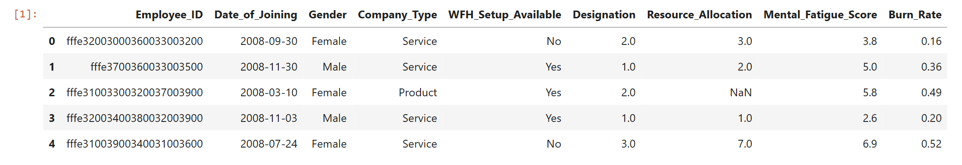
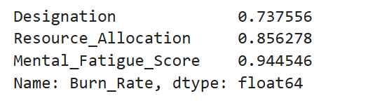
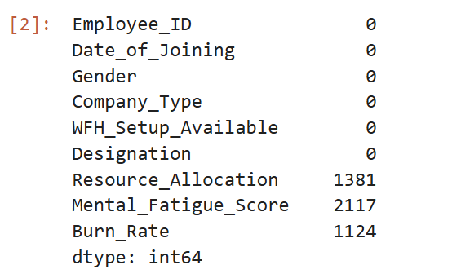
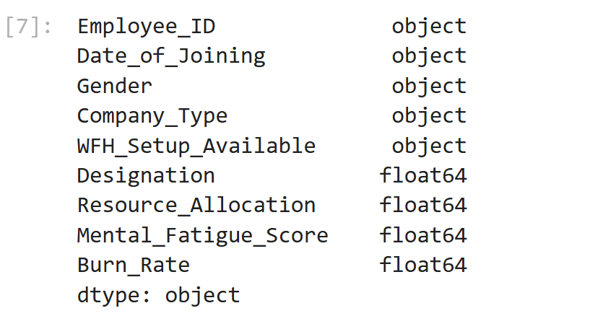
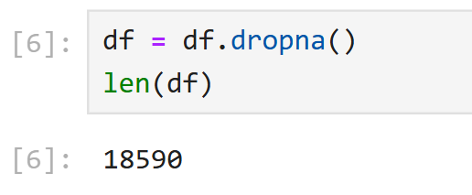
RESULTS

Slide 10
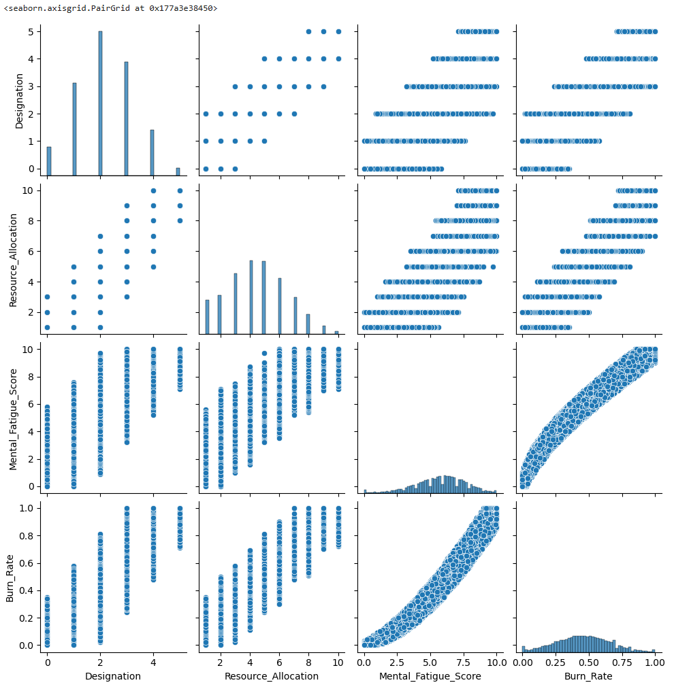
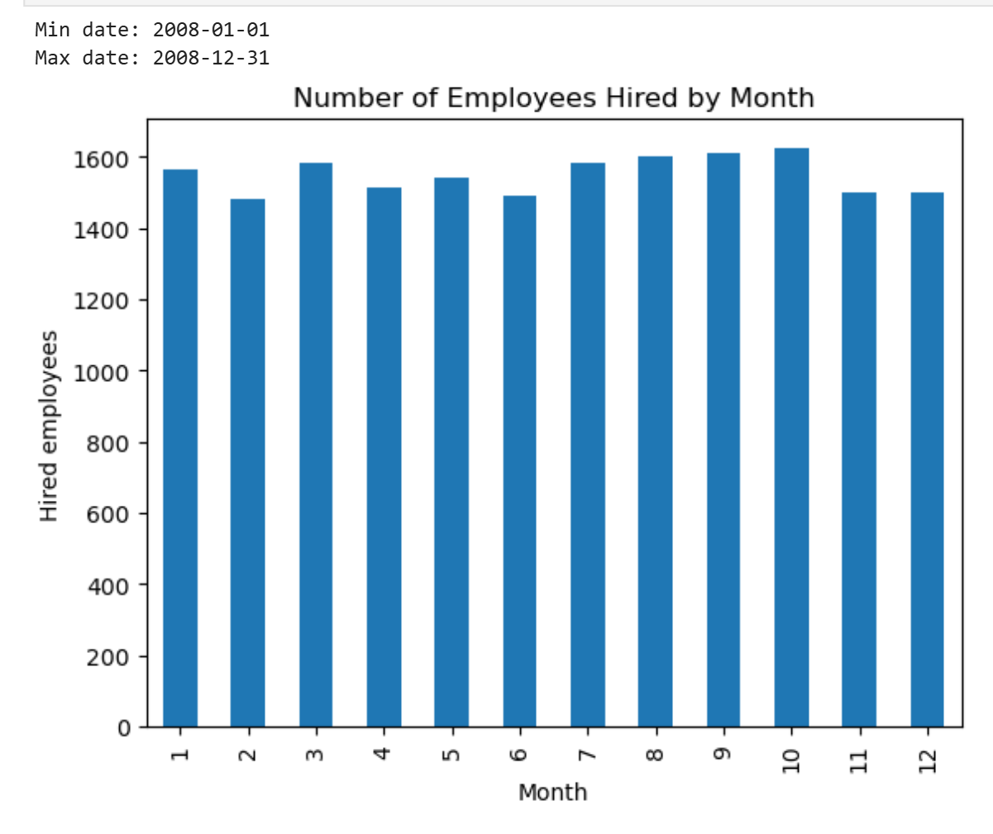
RESULTS

Slide 11
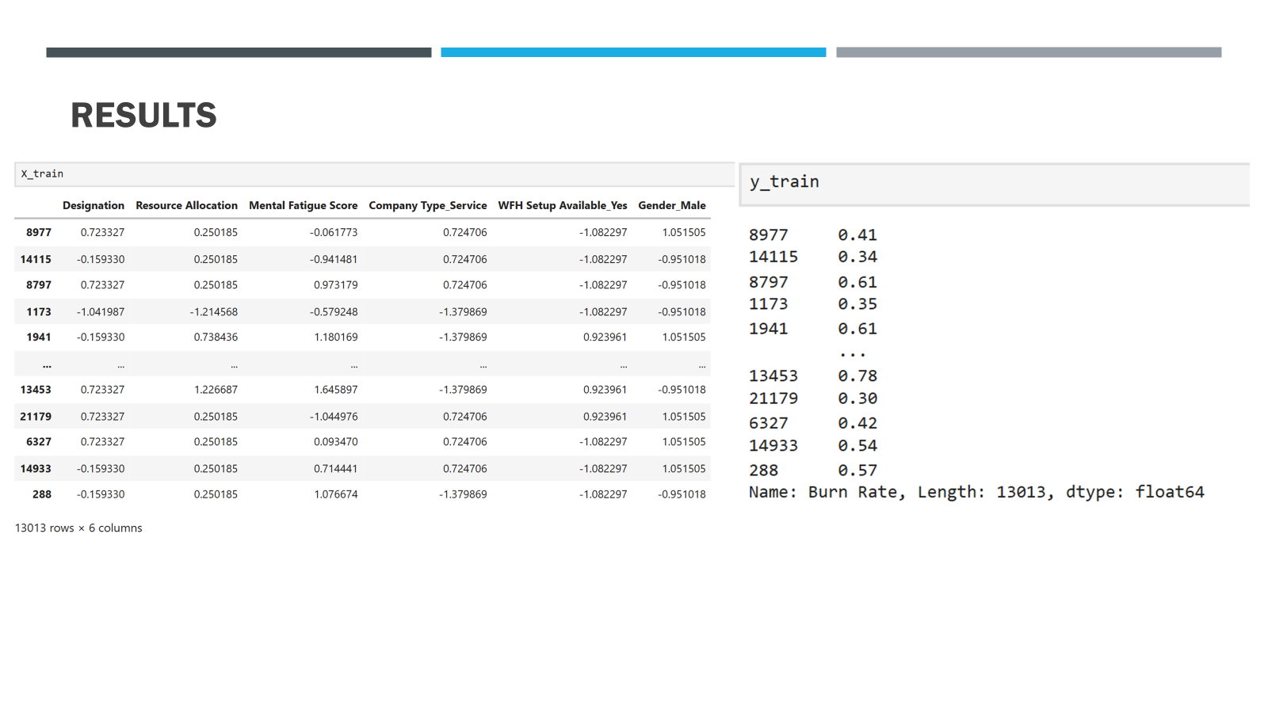
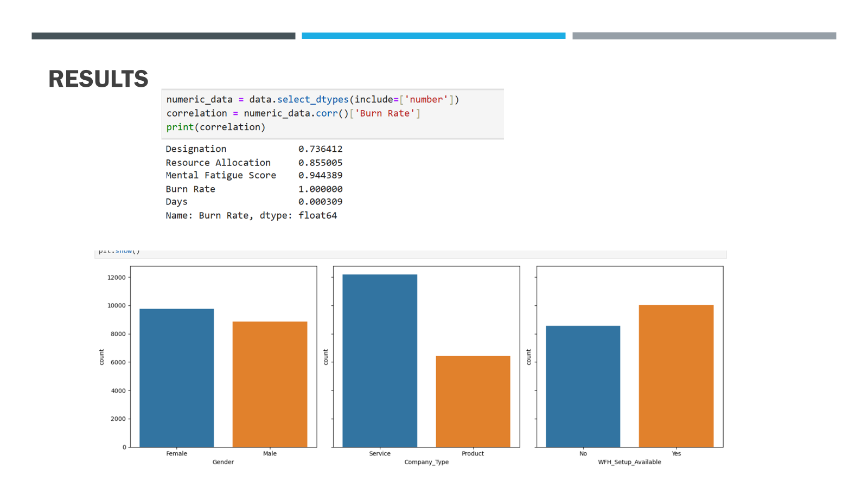
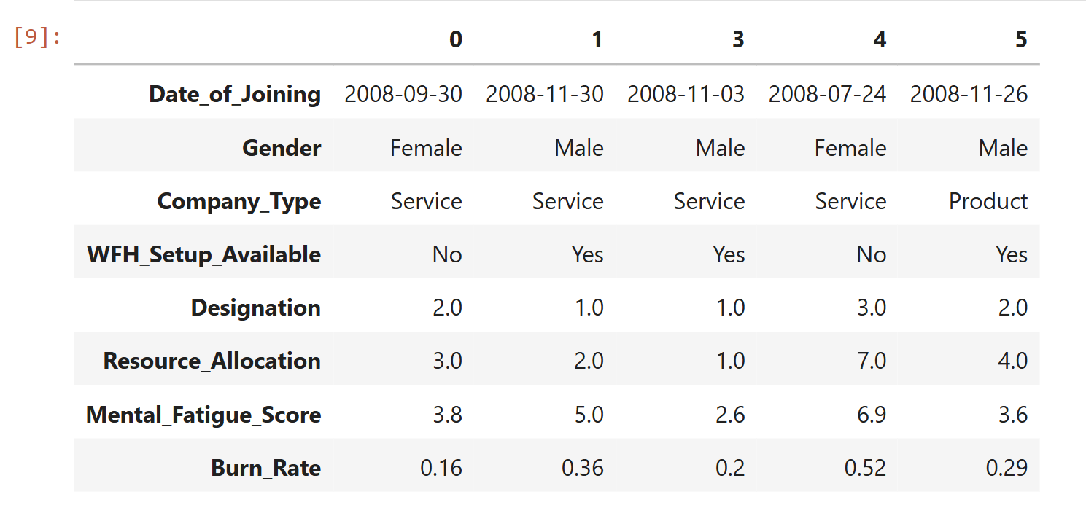
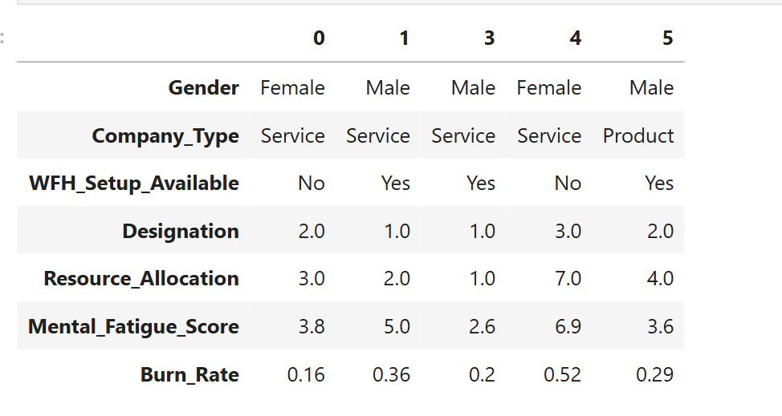
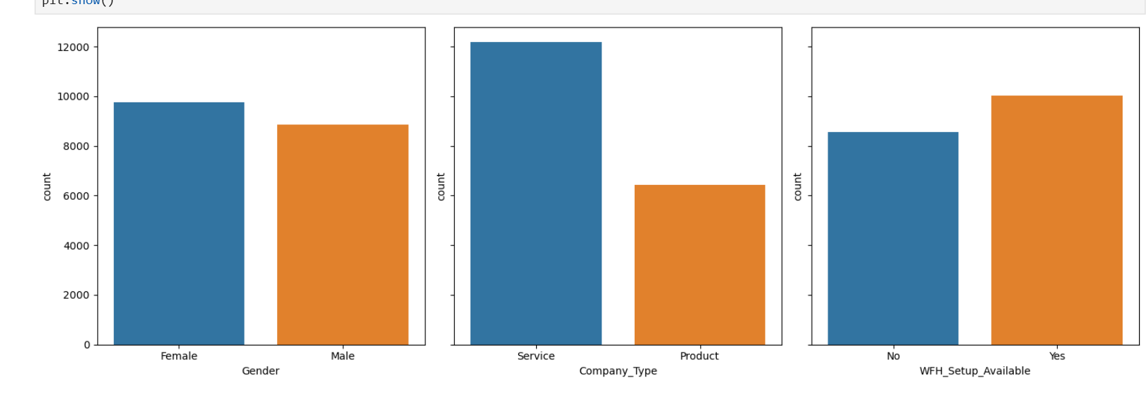
RESULTS

Slide 12
RESULTS

Slide 13
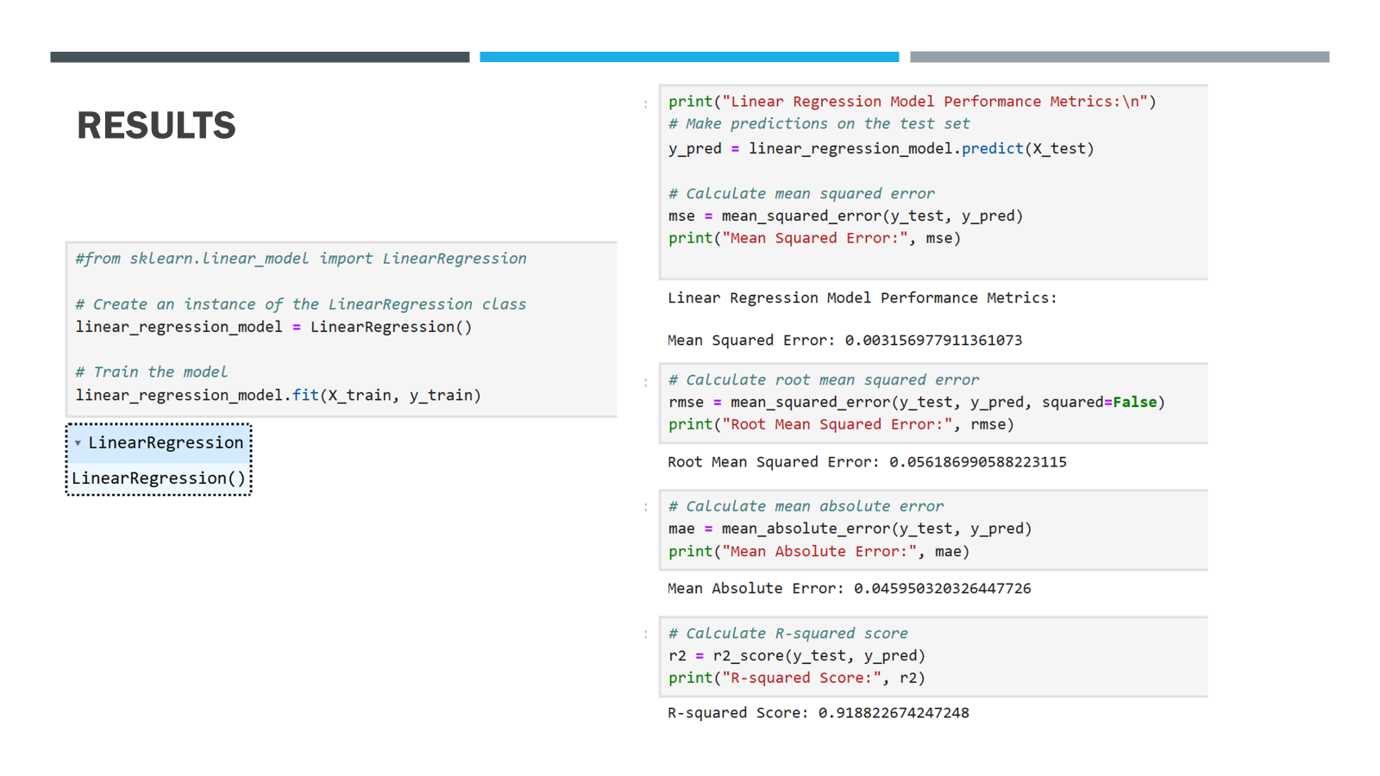
RESULTS

Slide 14
LINKS AND REFERENCES
Edunet tutorial
https://www.kaggle.com/datasets/blurredmachine/are-your-employees-burning-out

